Slide 1
TalenPit project
Change the face of recruitment

Slide 2
Structure of the website
Home page
This is going to be the only page on the website. It will comprise all the information about us, about what we offer, Contact us, leave us feedback, donation section and all the other extra such as terms of use, privacy and so on.
There will be two hidden pages
A)One for applicants and candidates to fill in an application and upload resumes and cover letter, some sort of dashboard where everything an applicant needs to create a perfect application for the world to see
B)One for businesses to have all the list of registered applicants with search bar and advanced search option to find exactly the perfect applicant that matches their requirements

Slide 3

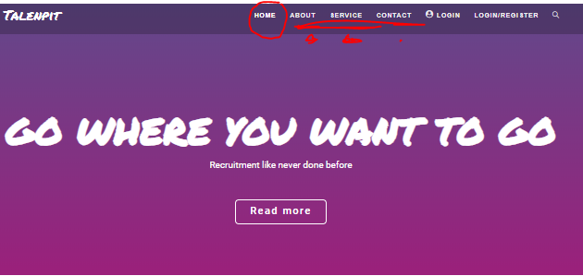
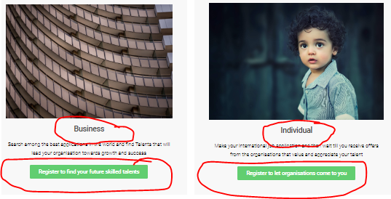
Home page in detail
Tabs such as about, service and contact should be visible in the top of the website. When clicked on the home page will scroll down automatically to the chosen section.
-------------------------------------------------
In home page we shall also have two action buttons as shown in the picture on the right to separate businesses from applicants and redirect them to their respective reserved pages.

Slide 4

Applicant page in detail
The applicant page is planned to have the following
Applicant dashboard that will have
Building a resumé and cover letter
Questions about personal life and ambitions
Questions about countries where applicants wants to work and live in
Questions about his skills
Any other questions available
Feature the applicant can use to send a link to friends and ex bosses to evaluate his skills (SurveyMonkey concept)
Open end text for applicant to express himself aside from a cover letter, to speak about his dreams and his plans for the future also allow the applicant to sell himself (small video upload also possible)
Notifications if his profile is checked
Message inbox where he can receive messages about the skills other companies were looking for when they were checking candidates (only if the a)
The rest is up to imagination
This page can only be accessed if the applicant clicks on the action button in the home page, otherwise it will be hidden
All applicants shall register to website first.

Slide 5
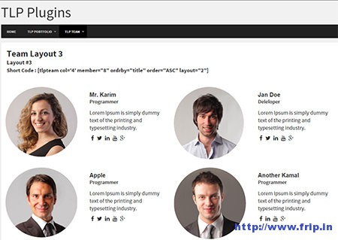
Business page in details
The business page is planned to have the following in their dashboard
All registered applicants will be visible in this page
Search bar and advanced search for business to look for the talent they need as shown in the picture on the right
A decent donation section to encourage business to support our cause
Feedback section to help us improve this page
Feature that allows companies to put 3 to 4 applicants in their favorite
When companies make a choice we need to ask them why and they have to answer so we can send feedback for the rejected applicants and tell them you did not get hired because of that automatically
Extra features is up to imagination
This page only accessed if a company clicks on the action button on home page, otherwise it will be hidden
All businesses shall register to website first

Slide 6
Extra features
Along the process of rebuilding this website we will have a lot of requirements for the themes, the headers, the footer, terms of use and privacy statements. The overall layout and many other small details.
The above is up to change for the reason of having a ready website that is simple, reliable, easy to use, loads faster and serves its purpose.

